Slide 1
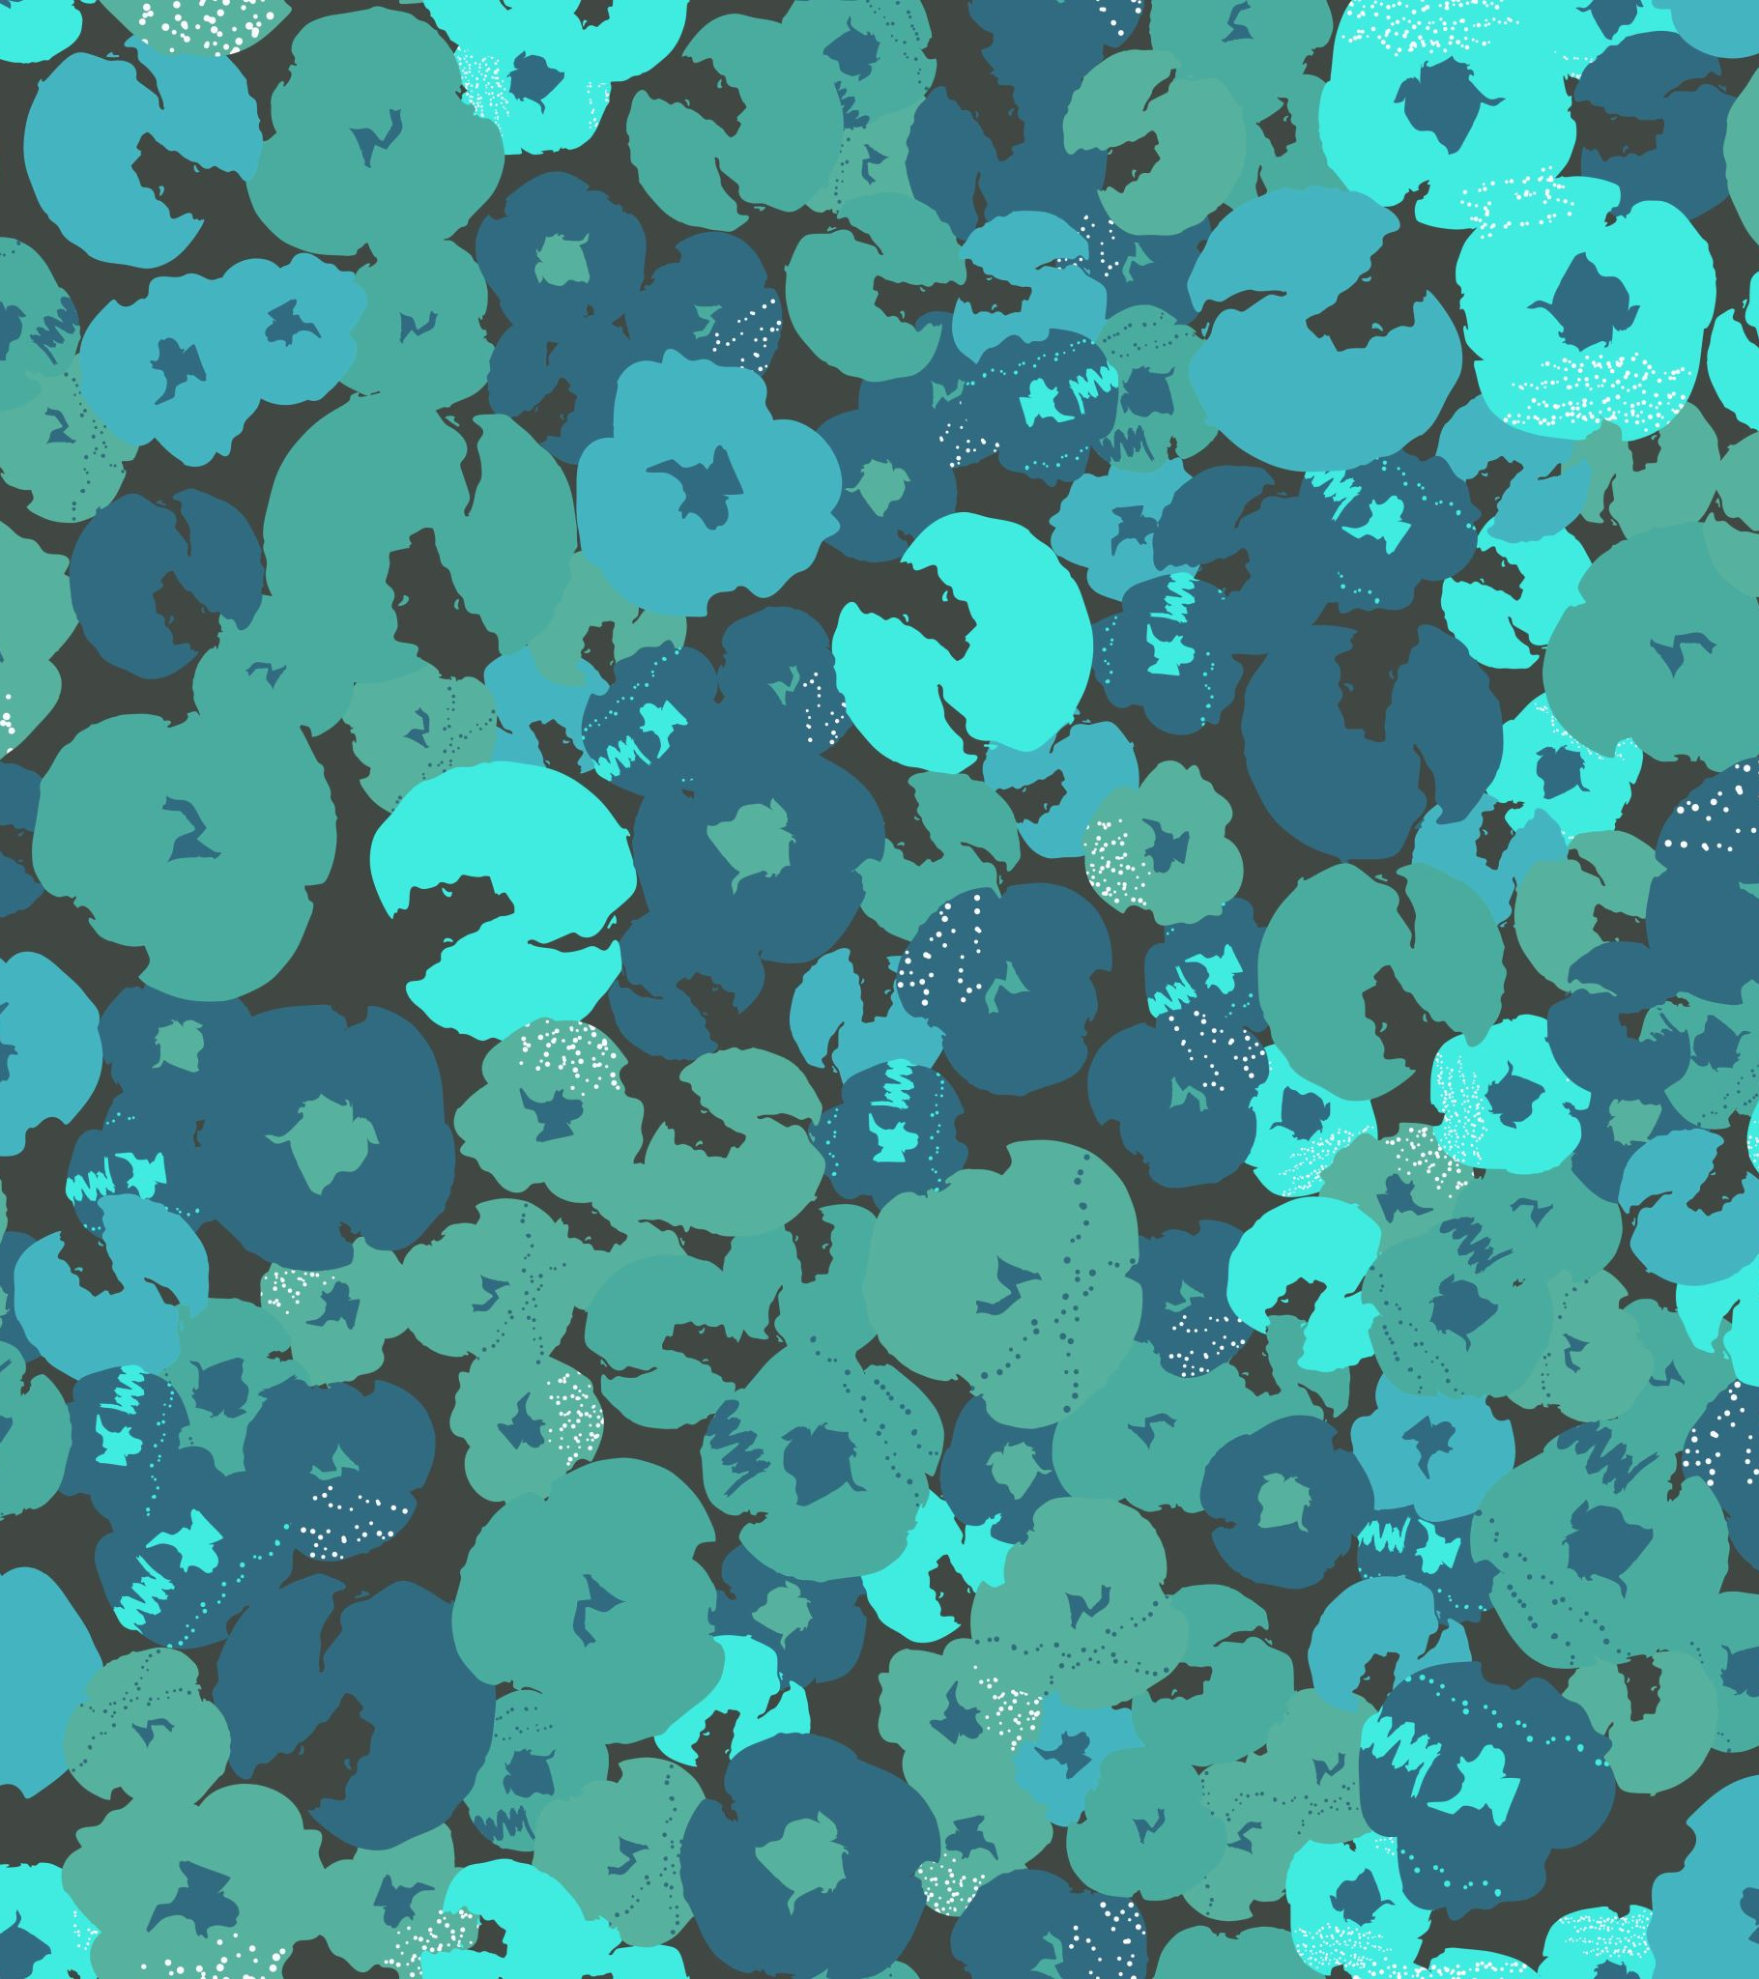
Connect 4 with minimax algorithm
Team members:
Karthik kannamreddy
Shashank reddy Yalala

Slide 2
Objectives
Goal is to build an agent to play against the user in a connect 4 game
Minimax algorithm will be used to help the agent beat the user

Slide 3
Connect 4 game Overview
This game Connect-Four is a tic-tac-toe game played by two players.
In this game the players take turns placing pieces on a vertical board.
The board is 7 columns long and 6 rows high.
Each player uses pieces of a specific color, usually black and red or sometimes green and red.
The goal is to be the first to get four pieces in a horizontal, vertical, or diagonal line.
Since the board is vertical, parts inserted in a certain column always fall in the lowest unoccupied row in that column.
As soon as a column contains 6 parts, it is full and no further parts can be placed on the column.
Both the players begin with 21 similar pieces and the first player to reach a series of four connected pieces wins the game.
If all the players have played and neither player has four parts in a row, the game is a tie.

Slide 4
What is minimax algorithm
It is a decision-making algorithm used in game theory.
It considers two players min and max, and min always picks up a minimum value score from game and max always picks up maximum value score.
The value for each game move is decided based on some heuristics.

Slide 5
Approach
Code will be written with the help of Javascript
HTML and CSS will be used to achieve the graphics of the game.

Slide 6
Deliverables
An index file with AVG HTML document which will help in running the game in a browser
Minimax javascript file will contain the code of execution of agent along with the game logic in it
A CSS file.

Slide 7
Evaluation methodology
To run the game, the AVG HTML document file needs to be executed
The game will be displayed in the browser.
Then the turn-1 of the game will be played by the Agent .In the next turn user will select any row from 7 rows and drop a coin
Winner will be decided when one of the player has the 4 coins connected in a horizontal, vertical or diagonal fashion.
Press space to retry.

Slide 8
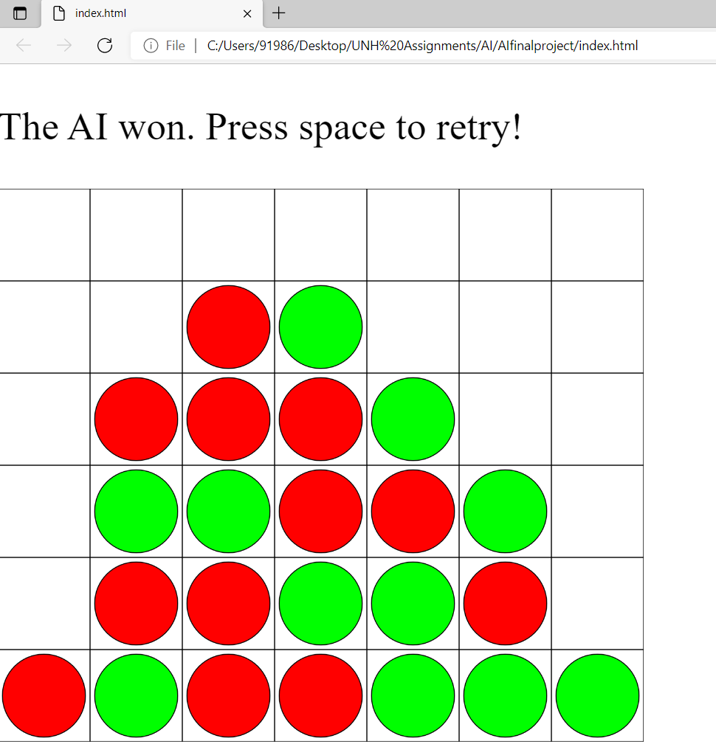
Game output

Slide 9

THANK YOU

